Slide 1
Designing Technology to Support Co-Tracking of Mental Wellbeing in Bipolar Disorder
Michael Hoefer
University of Colorado Boulder

Slide 2

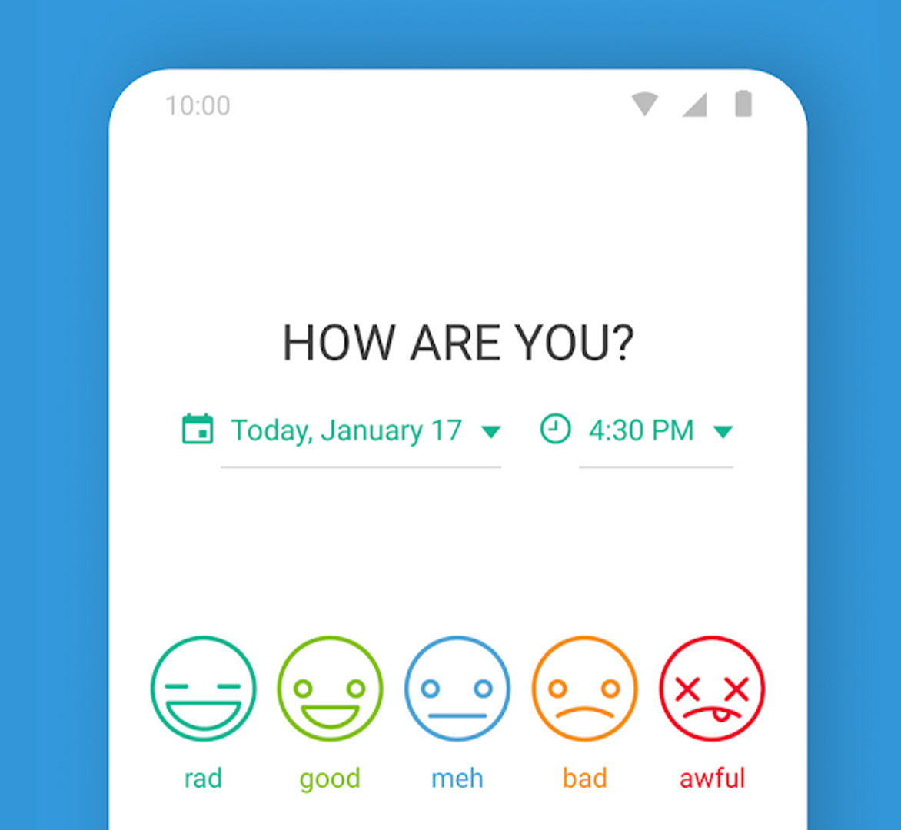
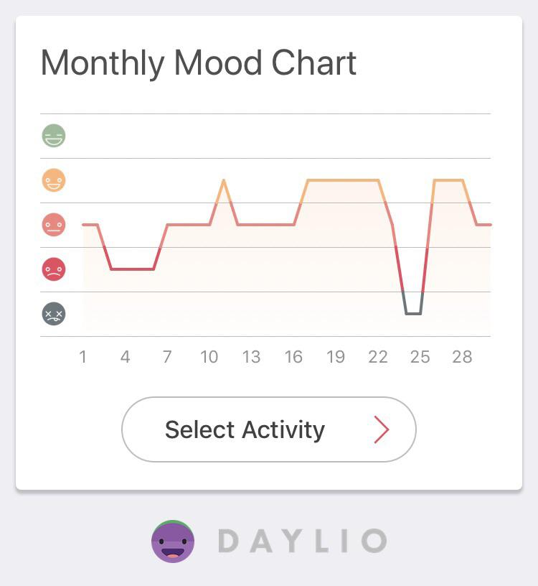
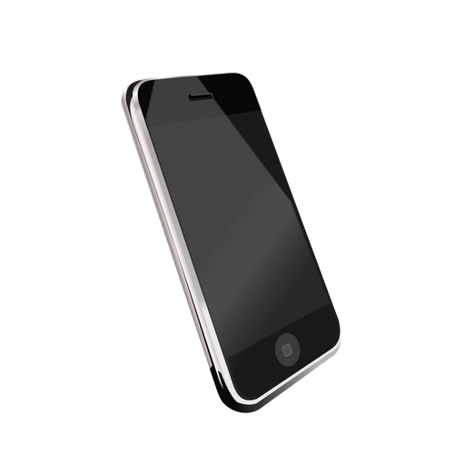
Traditional mood tracking applications facilitate
self-tracking
😔
Self-Tracker

Slide 3



What would happen if someone else tracked your mood too?
😃
🥰
?
😤
😜
😔
😒
😔
THEY?
???
Co-Tracker
Self-Tracker

Slide 4
Outline
What is co-tracking, and why might it help manage serious mental illness?
How can technology be designed to support co-tracking?
How can we evaluate co-tracking technology?

Slide 5
Outline
What is co-tracking, and why might it help manage serious mental illness?
How can technology be designed to support co-tracking?
How can we evaluate co-tracking technology?

Slide 6
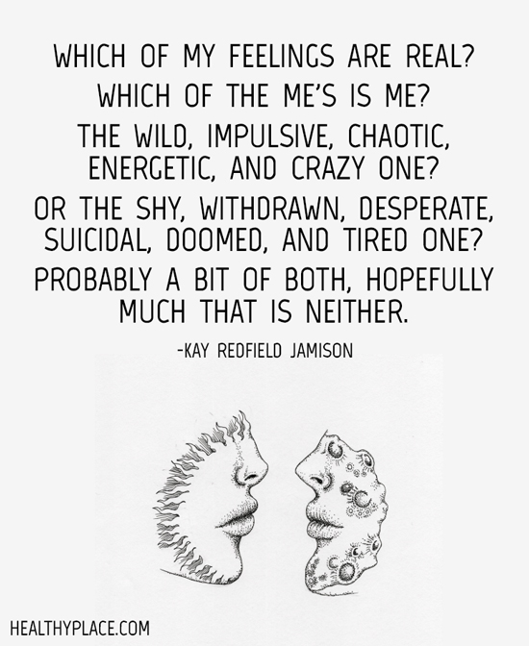
The case of bipolar disorder
Roughly 1% worldwide prevalence
Extreme changes in mood
Euthymia
Depression
Mania
Interpersonal and social rhythm therapy focuses on stabilizing daily rhythms and improving social functioning

Slide 7
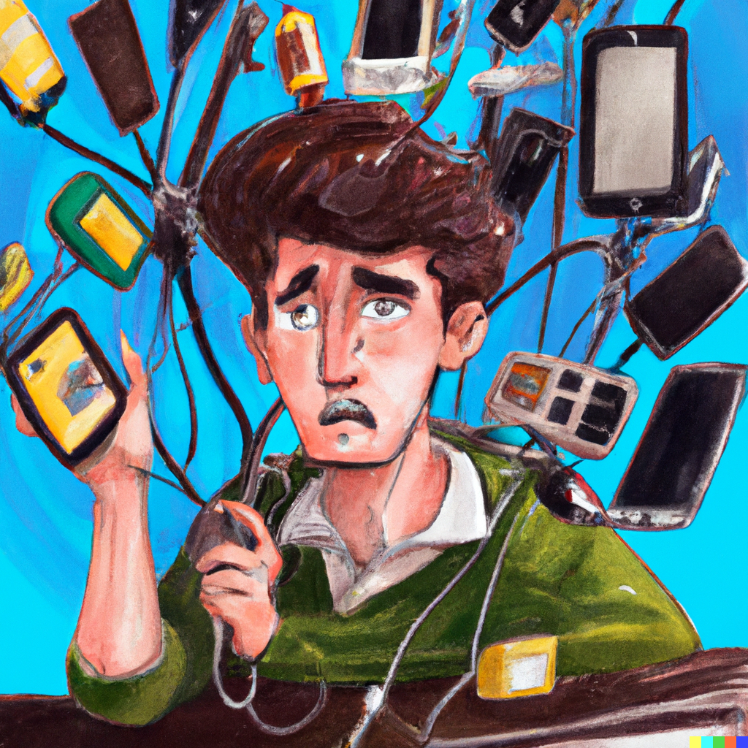
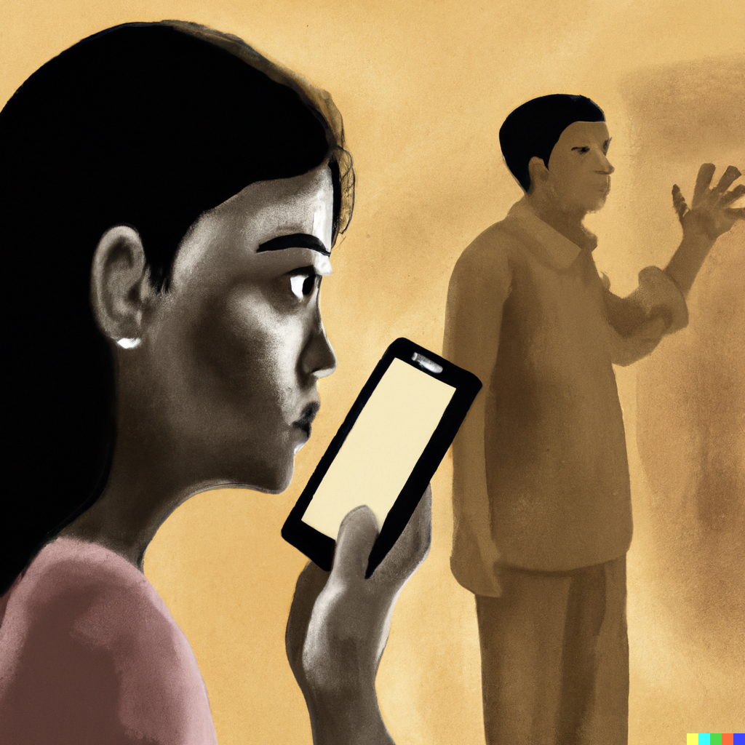
Co-tracking was found ‘in the wild’ by people managing bipolar disorder in a close relationship
Unable to self-track due to manic or depressive episode
Family member steps in to track on their behalf
Murnane, et al., 2018. “Personal informatics in interpersonal contexts.” CSCW

Slide 8
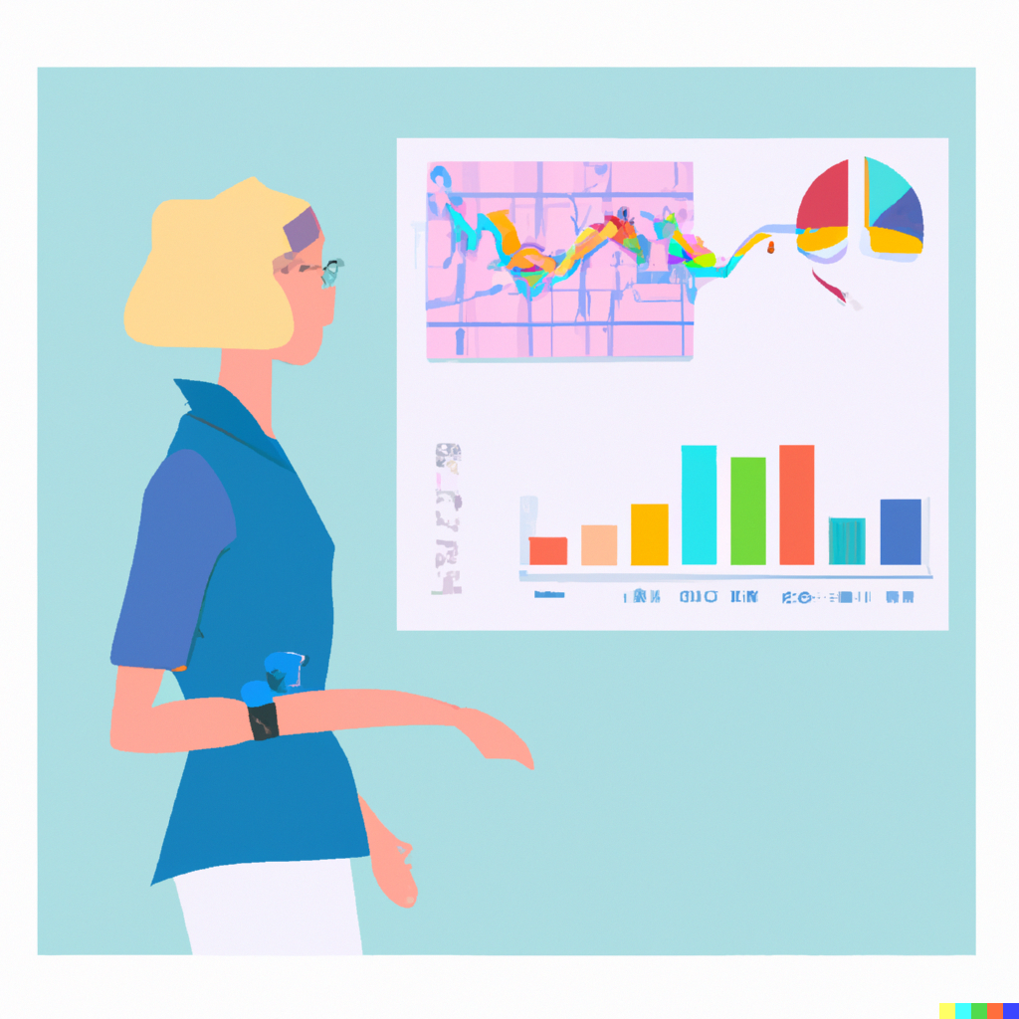
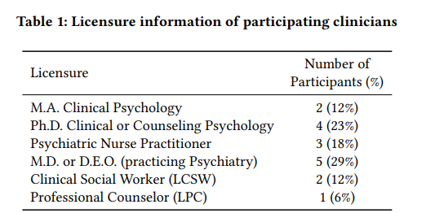
Clinicians want another perspective outside of the treatment context
Michael Hoefer, et al. 2021. The Multiplicative Patient and the Clinical Workflow: Clinician Perspectives on Social Interfaces for Self-Tracking and Managing Bipolar Disorder. In ACM Designing Interactive Systems 2021 (DIS '21). https://dl.acm.org/doi/10.1145/3461778.3461995

Slide 9
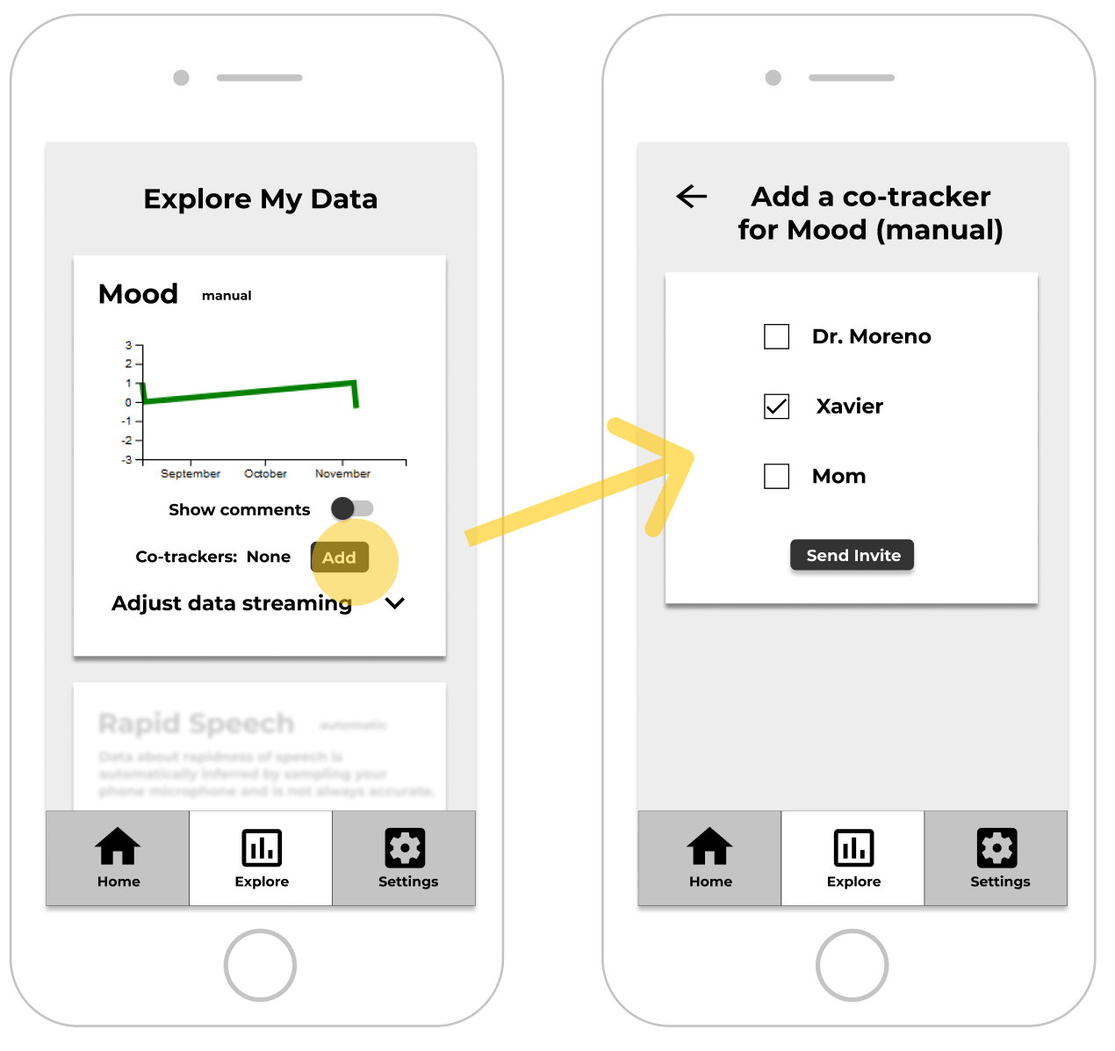
Patient’s
phone
8. Co-tracking
Comments
Good idea! Patients should have control over who co-tracks on their behalf

Slide 10
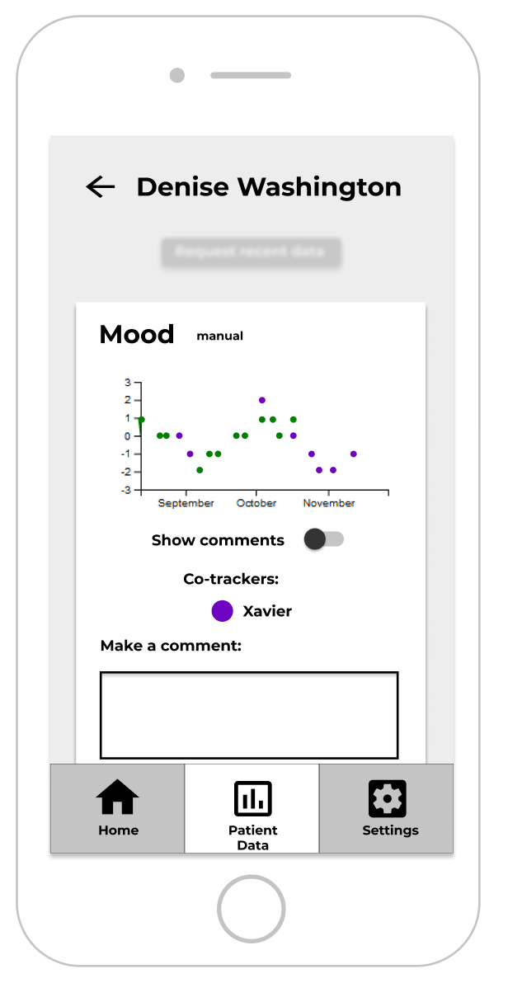
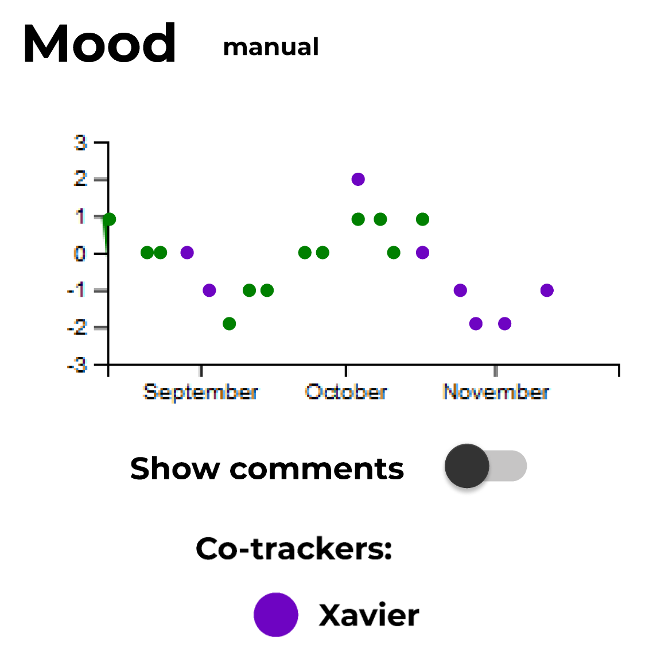
Clinician’s
phone
8. Co-tracking
Family/
Friend
phone
Comments
Hmmm, there’s a lot to having someone else track your mood.

Slide 11
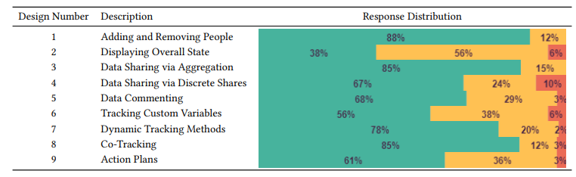
Co-tracking was one of the most “approved” features
“I like the idea of it, be a family member or friend who’s also seeing someone outside of the treatment context and maybe getting more of a naturalistic sense of who they are… and how things are changing and ebbing and flowing in…their real world contexts... this is a great idea.” –Clinician 2

Slide 12
We were motivated, but had this been done before?
Kind of, in psychology studies (person perception)
What can we learn from them?

Slide 13
Psychologists had people track their own mood, and track their perception of their partner’s mood
Partners’ expectations tended to come true…
Partner-Expected Affect
Mediated through contact
“Perceivers were not accurate in the majority of cases”
Sels, Ceulemans, and Kuppens, 2017. “Partner-Expected Affect: How You feel Now Is Predicted By How Your Partner Thought You Felt Before” Emotion.

Slide 14
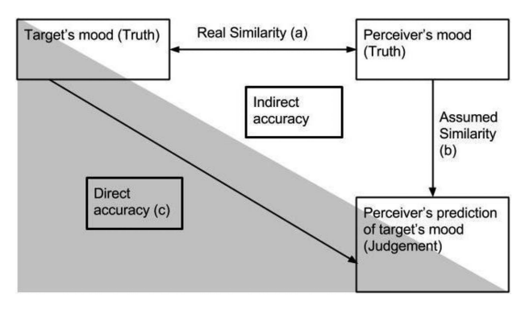
Projection noted as a major pathway for interpersonal perception
Co-trackers should track their own mood too
Clark et al., 2017. “Accuracy and projection in perceptions of partners’ recent emotional experiences: Both minds matter” Emotion.
Sened et al., 2017. “Now you have my attention: Empathic accuracy pathways in couples and the role of conflict” Emotion.

Slide 15

Empathic accuracy is beneficial in relationships, and can be improved!
We might want to share the co-tracked data
Barone et al., 2005. “Increasing Empathic Accuracy Through Practice and Feedback in a Clinical Interviewing Course” Journal of Social and Clinical Psychology.

Slide 16
Three motivations for co-tracking
Co-tracker helps maintain a record when an individual is unable to track
2. Provides clinicians with another perspective on their patient
3. Create feedback loops to improve empathic accuracy and relationship outcomes

Slide 17
Outline
What is co-tracking, and why might it help manage serious mental illness?
How can technology be designed to support co-tracking?
How can we evaluate co-tracking technology?

Slide 18

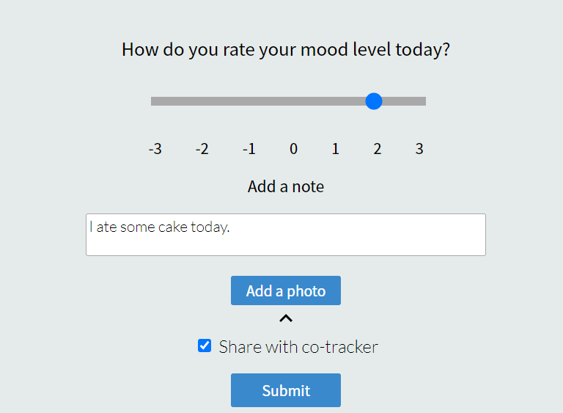
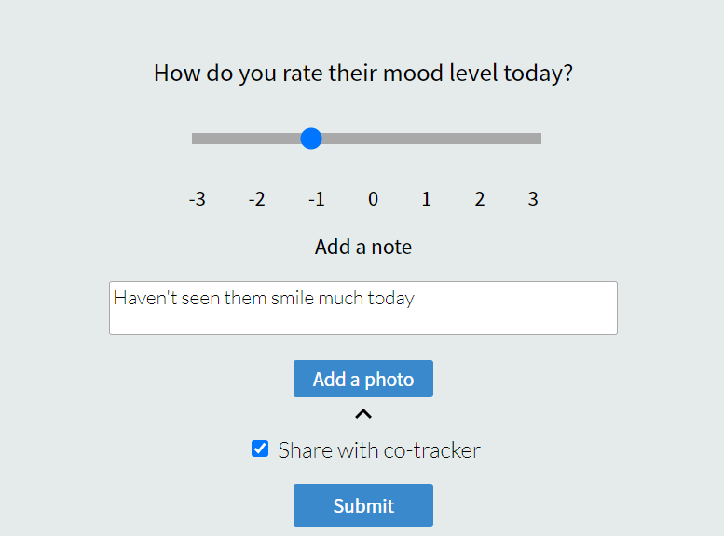
Developing MoodSync, a flexible self-tracking application

Slide 19
How should we visualize multiple data streams about mood?

Slide 20
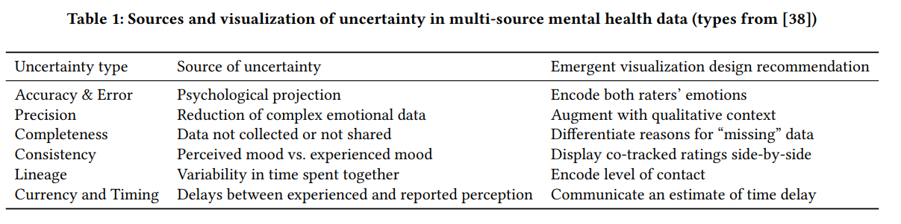
How should we visualize multiple data streams about mood?
“If I’m not able to trust that it’s the full dataset, is it even worthwhile?” –Clinician 5
Michael Hoefer, Bryce Schumacher, Danielle Albers Szafir, and Stephen Voida. 2022. Visualizing Uncertainty in Multi-Source Mental Health Data. In Extended Abstracts of the 2022 CHI Conference on Human Factors in Computing Systems (CHI EA '22). https://doi.org/10.1145/3491101.3519844

Slide 21
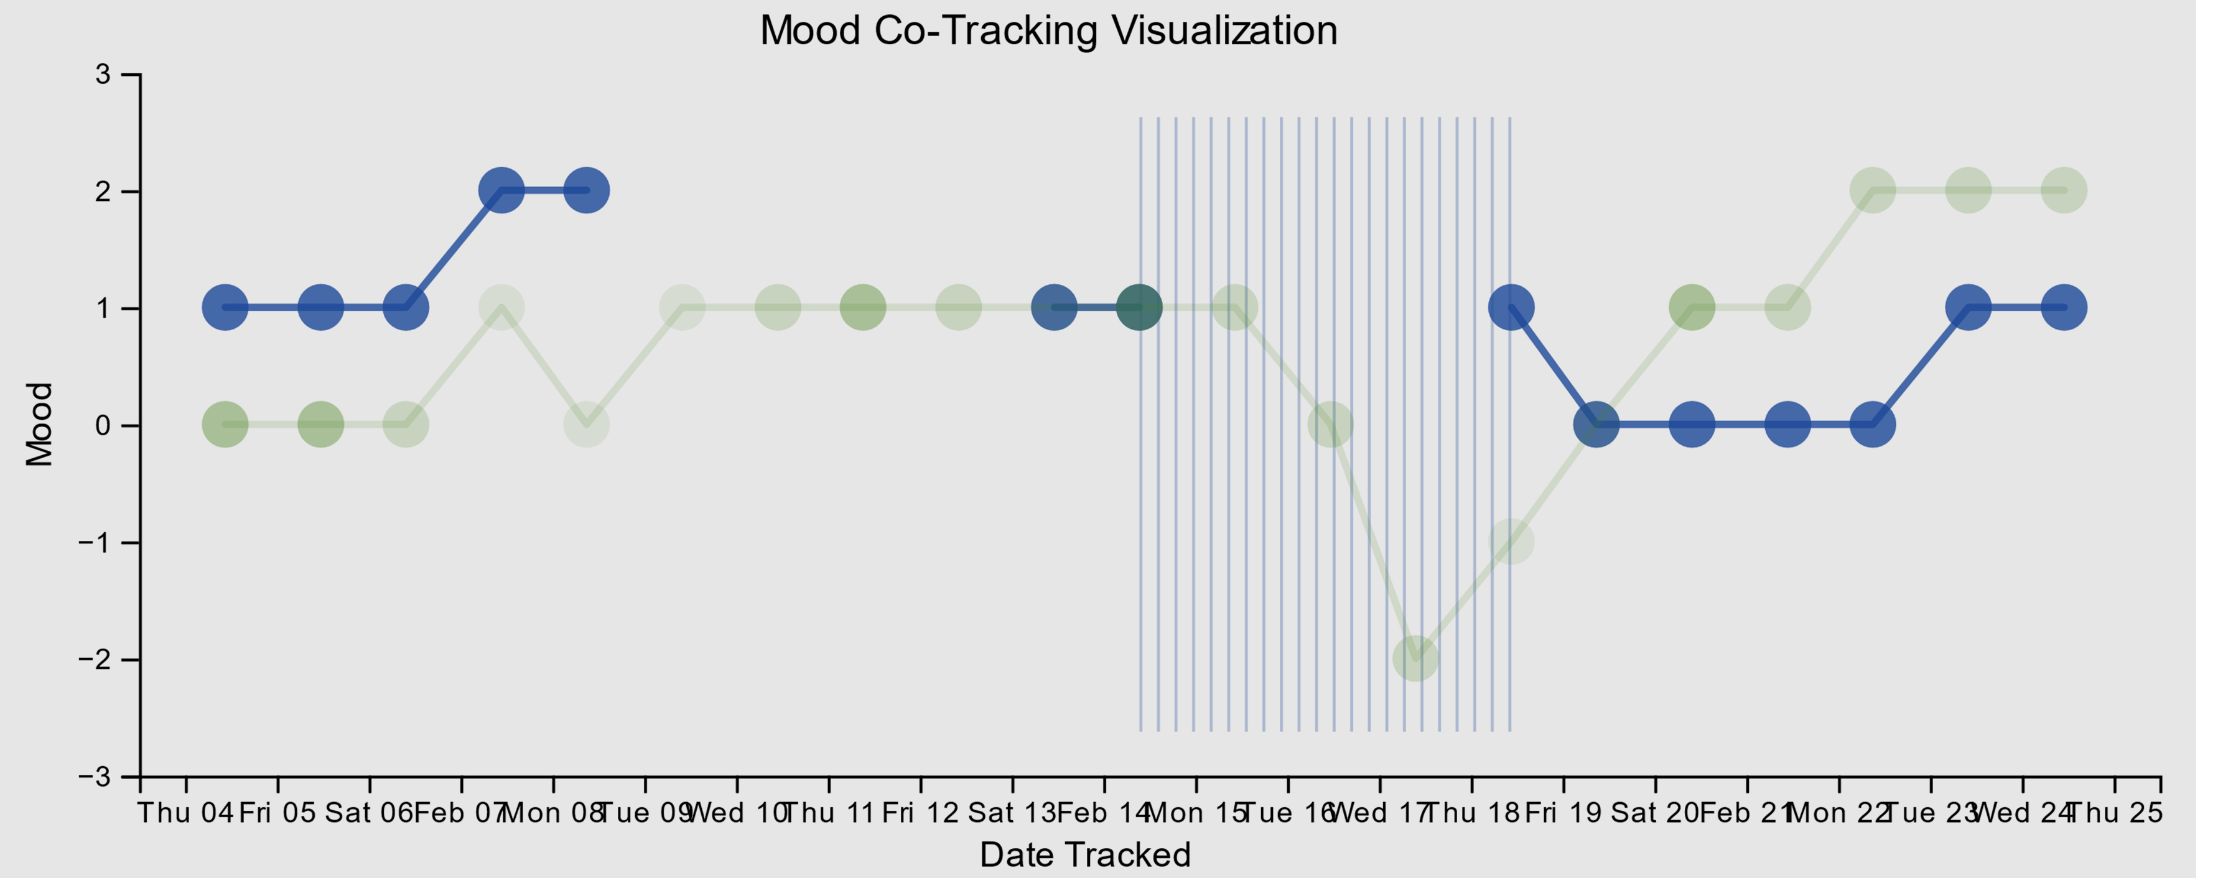
How should we visualize multiple data streams about mood?
Co-Tracking
Self-Tracking

Slide 22
How should we visualize multiple data streams about mood?
Co-Tracking
Accuracy and Error
Co-tracker may project own mood onto self-tracker
Mitigation: co-tracker also tracks own mood
Self-Tracking

Slide 23
How should we visualize multiple data streams about mood?
Co-Tracking
Consistency
Co-tracker and self-tracker may not agree
Mitigation: Display both data streams side by side
Self-Tracking

Slide 24
How should we visualize multiple data streams about mood?
No tracking
No sharing
Co-Tracking
Completeness
Self-trackers may not track every day, or choose not to share data
Mitigation: Clearly show reason for missing data
Self-Tracking

Slide 25
How should we visualize multiple data streams about mood?
Co-Tracking
More interaction
Low interaction
Lineage
Variable amount of interaction
Mitigation: Use visual channel to encode level of interaction (here, opacity)
Self-Tracking

Slide 26
Outline
What is co-tracking, and why might it help manage serious mental illness?
How can technology be designed to support co-tracking?
How can we evaluate co-tracking technology?

Slide 27
In-situ deployment planned this spring
Small N, largely qualitative focus
Parents and children managing BD
College aged students in a relationship where BD is present

Slide 28
In-situ deployment planned this spring
Two month deployment
Intra-subject study design
First two weeks → self-tracking (baseline)
Last six weeks → co-tracking

Slide 29
Primary research questions
What is the experience of co-tracking like for both the tracker and the tracked?
How does sharing data impact the relationship?
How useful is co-tracked data for clinicians?

Slide 30
Future work
Finish development and release public app
Expand to larger studies with different populations
Large scale data of interpersonal perception

Slide 31












Thank you!
Prof. Stephen Voida
Director, TMI Lab
Tian Xu
Estevan Sandoval
Lucy Van Kleunen
Venkat Arigela
Namratha Mysore Keshavaprakash
Lizzie Bartholomew
Shreyas Savanoor Ravindra
Cassandra Goodby
Divya Bhat
Lanea Blackburn
Bryce Schumacher
And thanks to all members of the TMI lab, including Janghee Cho, Fuji Robledo, Kit Lewers, and Shiva Darian

Slide 32

Questions, feedback, and collaborations welcome!
Michael Hoefer
michael.hoefer@colorado.edu
Department of Computer Science
University of Colorado Boulder
michaelhoefer.com
Related publications:
Michael Hoefer, Bryce Schumacher, Danielle Albers Szafir, and Stephen Voida. 2022. Visualizing Uncertainty in Multi-Source Mental Health Data. In Extended Abstracts of the 2022 CHI Conference on Human Factors in Computing Systems (CHI EA '22). https://doi.org/10.1145/3491101.3519844
Hoefer, et al. 2021. The Multiplicative Patient and the Clinical Workflow: Clinician Perspectives on Social Interfaces for Self-Tracking and Managing Bipolar Disorder. In ACM Designing Interactive Systems 2021 (DIS '21). https://dl.acm.org/doi/10.1145/3461778.3461995

